Slide 1

Real Estate Management System
Group No.
B10

Slide 2


Group Members:
Itasha Modi
TSP Abhishek
Suraj Yadav
Ujjwal Kumar
20BAI10382
20BCE10012
20BAI10377
20BCE10008

Slide 3
Technologies used
MongoDB: MongoDB is a NoSQL database that can be used to store and manage property listings, tenant information, lease agreements, and other data related to real estate management. It provides flexibility and scalability for handling large volumes of data.
React: React is a popular JavaScript library for building user interfaces. It allows you to create reusable UI components and efficiently update and render the user interface based on changes in data. React provides a robust and interactive front-end for the real estate management system website.
CSS (Cascading Style Sheets): CSS is used for styling and designing the website's appearance. You can define styles for various elements, layout properties, responsive design, and animations to create an aesthetically pleasing and user-friendly interface.
HTML (Hypertext Markup Language): HTML is the standard markup language used for structuring the website's content. It defines the layout, headings, paragraphs, links, forms, and other elements that make up the website's structure.
JavaScript: JavaScript is a programming language that provides interactivity and dynamic functionality to the website. It can be used for client-side form validation, user interactions, data manipulation, and integration with APIs.
Webpack: Webpack is a module bundler that can be used to bundle and optimize the website's assets, including JavaScript, CSS, and images. It simplifies the deployment process and improves the website's performance.

Slide 4
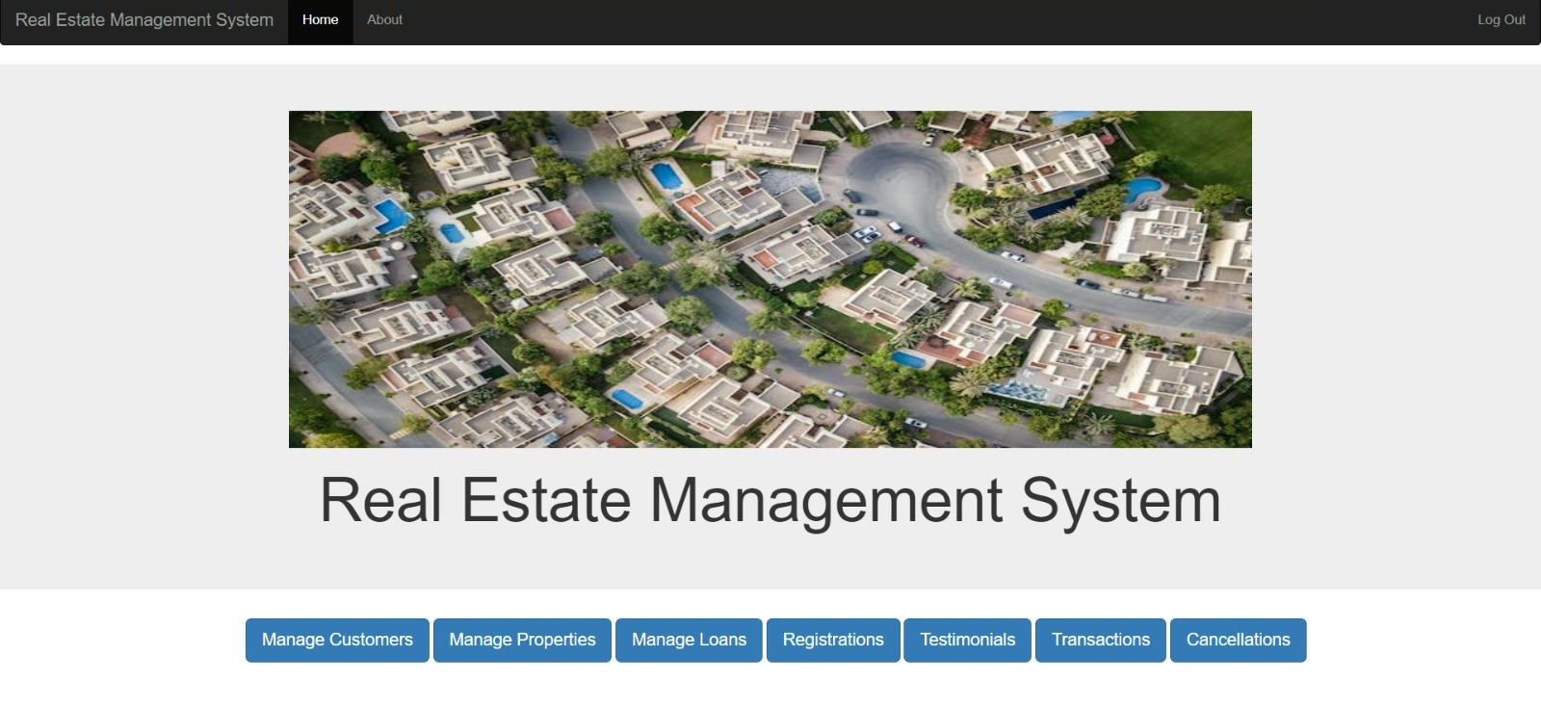
Front end Image

Slide 5
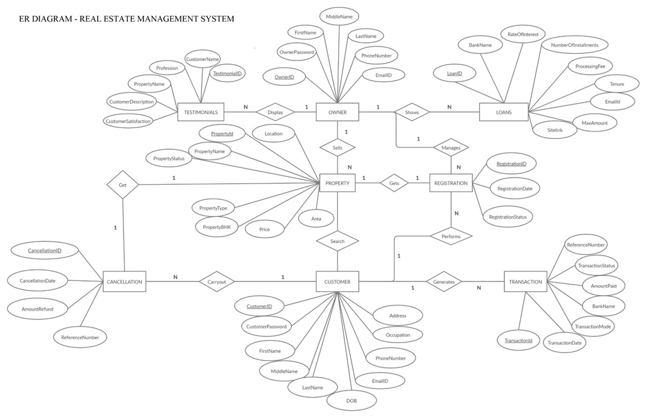
ER diagram

Slide 6


